Slide 1

Hazardous Material Transportation
Airbag Transportation Training

Slide 2
Issues
Undeployed Airbags: ISRI Task Force
Propellants: sodium azide, ammonium nitrate, guanidine nitrate, others
Agencies:
  EPA – Toxic hazard
  DOT – Transportation safety hazard
  NHTSA – Safe operation (Takata recall)
HazMat Transportation Training for
Lithium Batteries

Slide 3
Types of Airbags
Frontal airbags
Side torso airbags
Side curtain airbags
Knee airbags
Rear curtain airbags
Center airbags
Seatbelt airbags
Pedestrian airbags

Slide 4
Training Applicability
If you ship or deliver airbag components
Hazardous Material Employers (supervisors)
Hazardous Material Employees
  Shipping personnel
  Drivers
Carriers (UPS, Fed Ex, Speedy)
  May impose more restrictions
  May have own training programs and software

Slide 5
Training Requirements
All HazMat employers/employees require:
  General awareness
  Function specific
  Safety
  Driver (for those who deliver HazMat)
Initial Training: within 90 days
Renew Training: every 3 years
Training/certification must be documented

Slide 6
HazMat Training Content
Shippers
Drivers
How to package airbags
How to fill out shipping forms
Pre-trip safety inspection
Loading/unloading haz mat
Package handling
Emergency response
Incident reporting

Slide 7
Hazardous Material
Hazardous Materials include any substance which has been determined by the US Department of Transportation (DOT) to potentially pose an unreasonable risk to health, safety, or property when transported in commerce.

Slide 8
Airbag Components
Airbag module
Airbag inflator
Seat belt pre-tensioner
Pyrotechnic and compressed gas components are hazardous

Slide 9
Airbag Component Types
Component
Type
Airbag module and inflator
Seat belt pre-tensioner
Pyrotechnic
Compressed gas
Pyrotechnic
Electrical
Mechanical

Slide 10
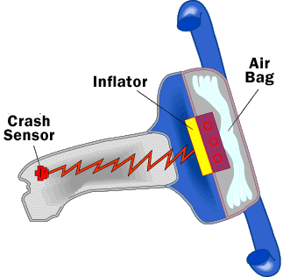
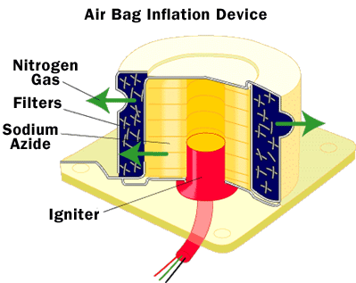
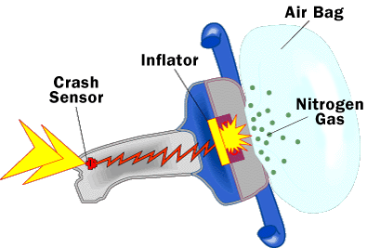
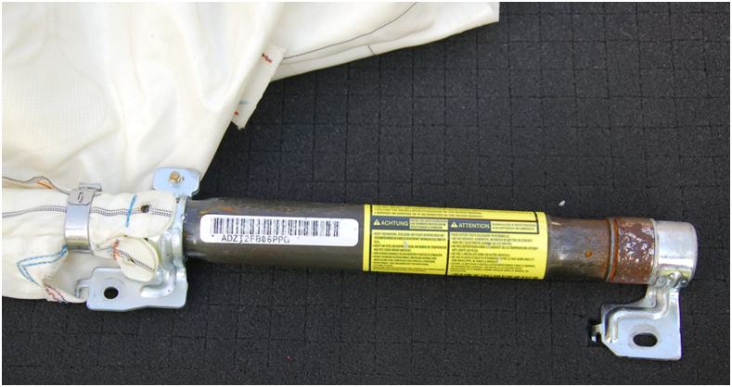
Propellant
Compressed Gas Cylinder Side Curtain Airbag

Slide 11
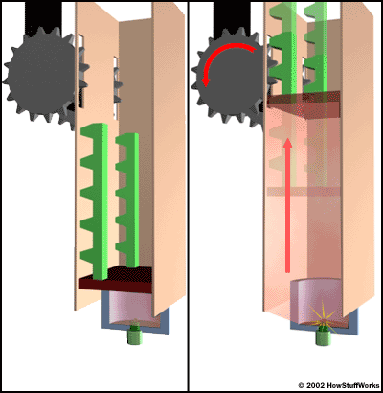
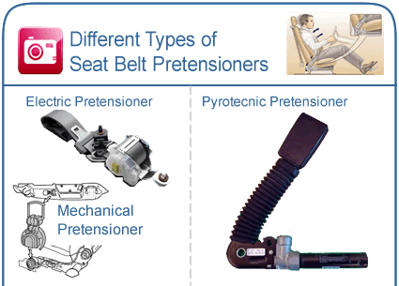
Pyrotechnic Pretensioner Operation

Slide 12
HazMat Shipping Information
Proper shipping name
Hazard Class (1 – 9)
United Nations (UN) Identification Number
Packing Group
  I Great danger
  II Medium danger
  III Minor danger
EX Number or Product Code

Slide 13
Pyrotechnic Airbag Module, Inflator, and Seat Belt Pre-tensioner
Hazard Class 9,UN3268 – Electrically Initiated
Hazard Class 1.4G,UN0503 - Pyrotechnic
Packing Group – Leave Blank
EX Number: Recycled

Slide 14
Pyrotechnic Airbag Module, Inflator, and Seat Belt Pre-tensioner
Proper shipping name:
“Safety Devices – electrically initiated” for 9,UN3268
“Safety Devices – pyrotechnic “ for 1.4G, UN0503

Slide 15
Compressed Gas
Airbag Module and Inflator
Hazard Class 2.2 (nonflammable gas)
UN3353
Packing Group – Leave Blank
EX Number: Recycled

Slide 16
Compressed Gas
Airbag Module and Inflator
Proper shipping name:
Safety Devices- compressed gas, 2.2, UN3353, Recycled, 5 lbs

Slide 17
24-Hour Emergency Response Telephone Number
Must register with an emergency service
Commonly used:
INFOTRAC
800-535-5053

Slide 18
HazMat Shipping Form
General Requirements
Must be legible and printed in English
No abbreviations or profanities
Retain in vehicle within arm’s reach of driver
On driver’s seat when not in vehicle
Retain all shipping forms for at least one year

Slide 19
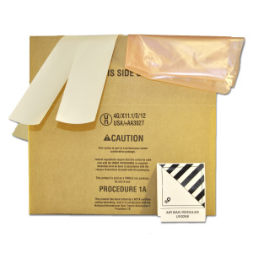
UN Specification Packaging
4 G Fiberboard Box
Do not cover UN Certification marking
Cushion to prevent movement
Total weight of package cannot exceed UN specified weight allowance
One unit per box

Slide 20
Driver Responsibilities
Ensure all boxes have HazMat shipping forms and labels
Keep shipping papers in proper location (arm’s length)
Secure boxes in vehicle
In an emergency:
  911
  Emergency Response Number (INFOTRAC)
  Your company
HazMat Incident Report Form 5800.1

Slide 21
Q & A
Can an owner/operator train and test himself?
  Yes
Are there certified HazMat trainers?
  No, but employer must ensure qualified training
Do you have to “pass” the test?
  No, but you must be able to perform your duties
What is the penalty for violations?
  $27,500 per violation (civil)
  $250,000/5 years (criminal)

Slide 22

SUMMARY
HazMat (Airbag) Transportation
HazMat shipping forms
UN Specified packaging and box
Driver responsibilities
24 hour emergency response (Infotrac)
Renew every 3 years

Slide 23

For more information:
$25
Warning
It’s a 9-hour CD-ROM
PHMSA HazMat Transportation Training Module 5.1

Slide 24
David Kendziorski
414-943-1773
dave@stormtech1.com

