Slide 1

SAFETY BY THE NUMBERS
TJ PHELAN
ACCOUNT EXECUTIVE
(574)344-6592
tphelan@arrowheadgrp.com
The most common insurance losses within the industry and how to prevent them

Slide 2
The Two Most Common Losses
1. Auto
This is not industry specific. Auto claims are the highest paid out claims across the country
As of 2020 the average cost for an automobile claim was $30,829
Distracted Driving is recognized as the leading cause (28% of all auto claims are from Distracted Driving, surpassing Drinking and Driving)

Slide 3
The Two Most Common Losses
2. Fire
This is industry specific.
The average cost of a fire is $35,000 (In Recycling Times that by 20)
Fires are not only catastrophic for the business, but also extremely dangerous for everyone involved in a business
Industry specific causes range from cutting torch usage, improper fluid draining, smoking in the dismantling area, and improper handling of stored vehicles

Slide 4
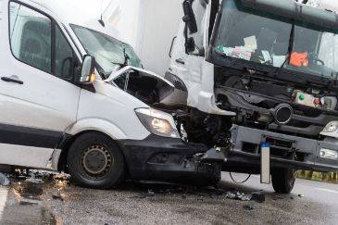
Auto: Distracted Driving Causes, Results, and Prevention

Slide 5

A picture’s worth a thousand words…

Slide 6

A picture’s worth a thousand words…

Slide 7

A picture’s worth a thousand words…

Slide 8
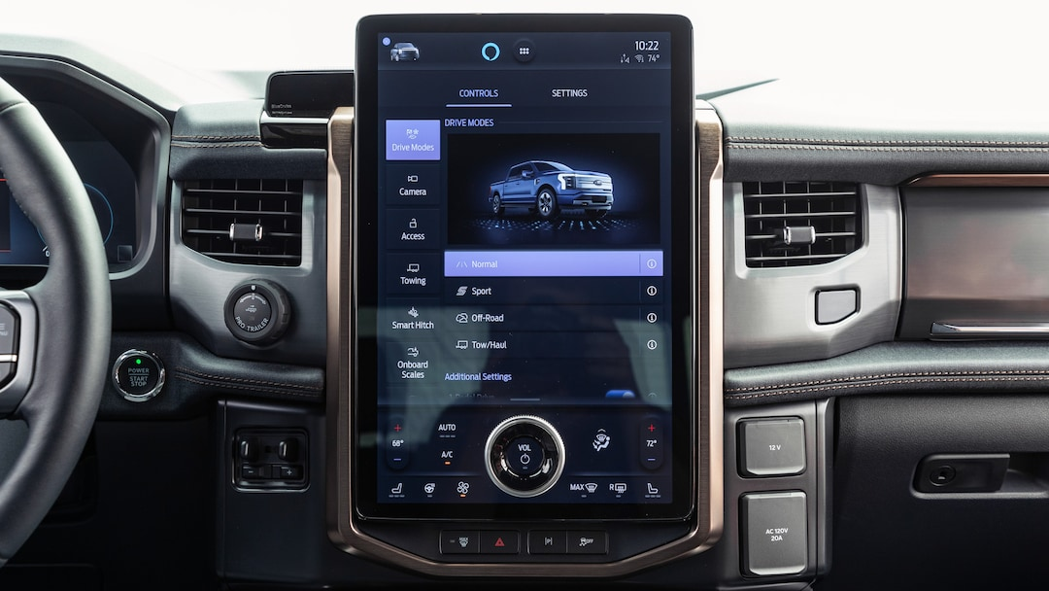
A picture’s worth a thousand words…

Slide 9
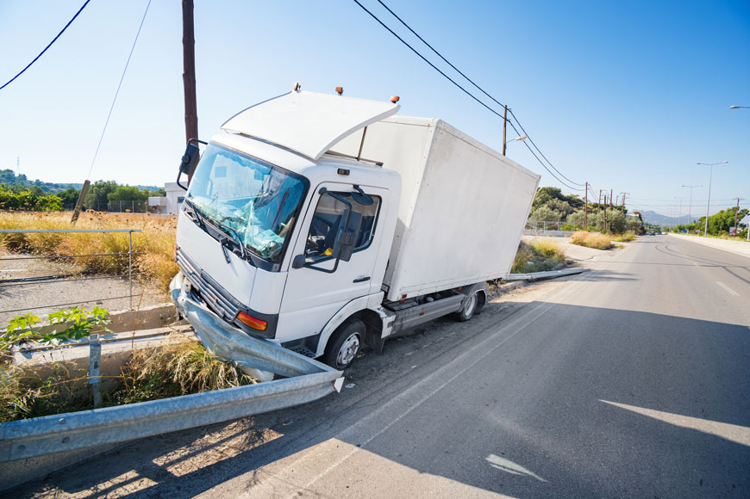
A picture’s worth a thousand words…

Slide 10
Did you know……
The average person reads a text in about 4.6 seconds. At 55mph, a car travels 80 feet every second.
Reading a text while driving is therefore just like driving the length of a football field blindfolded.
(www.osha.gov/publications/3416distracted-driving-flyer.pdf)
If a driver’s eyes are away from the roadway for just two seconds or more in a six-second window, the risk of being involved in a crash is two times higher than that of an alert driver.

Slide 11
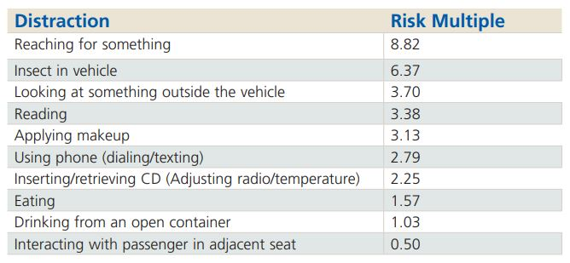
Did you know……
Distracted Driving can be any activity that takes hands off the wheel, eyes away from the road, or the mind to another place.

Slide 12
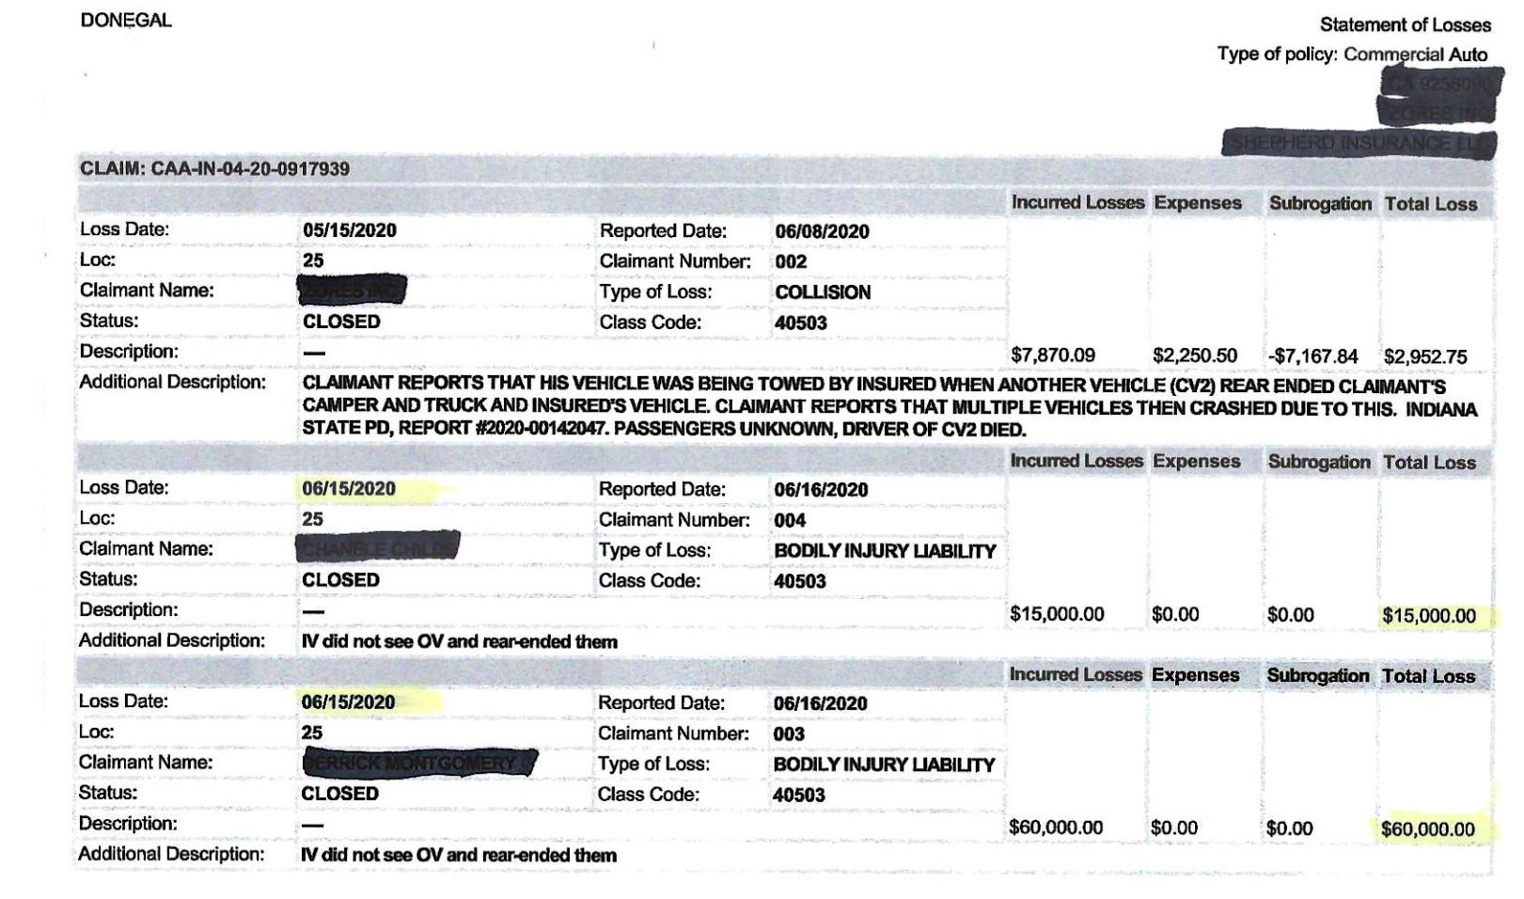
Do you see a theme here??? (page 1)

Slide 13
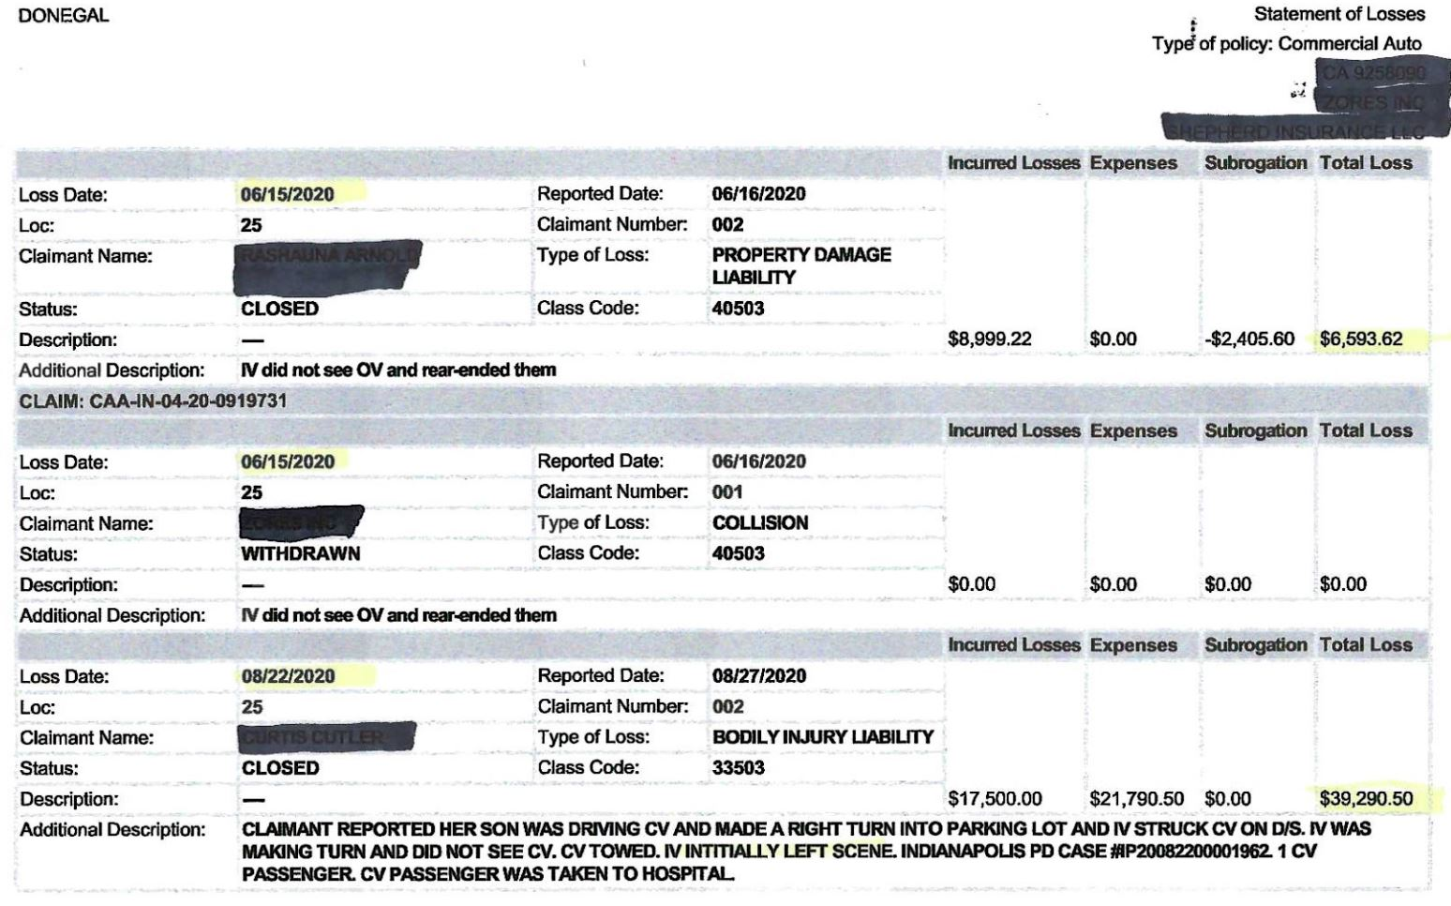
Do you see a theme here??? (page 2)

Slide 14
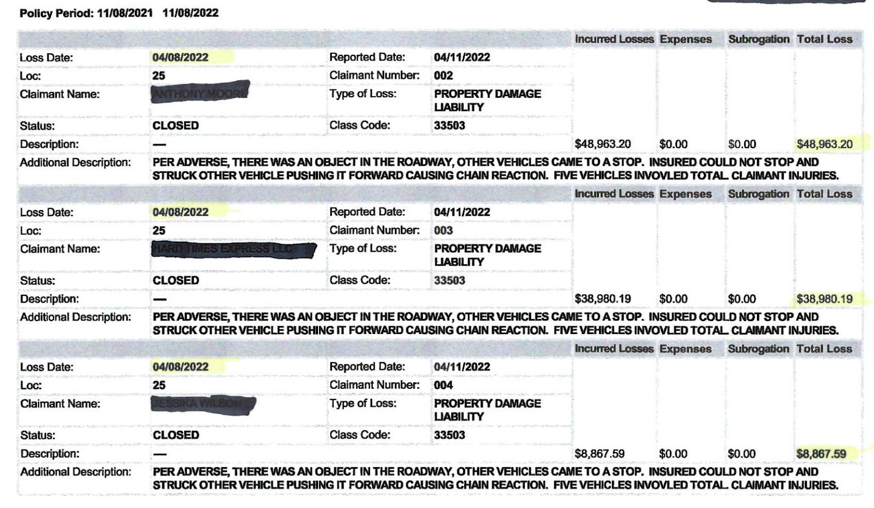
Do you see a theme here??? (page 3)

Slide 15
Remember, a picture’s worth a thousand words……

Slide 16
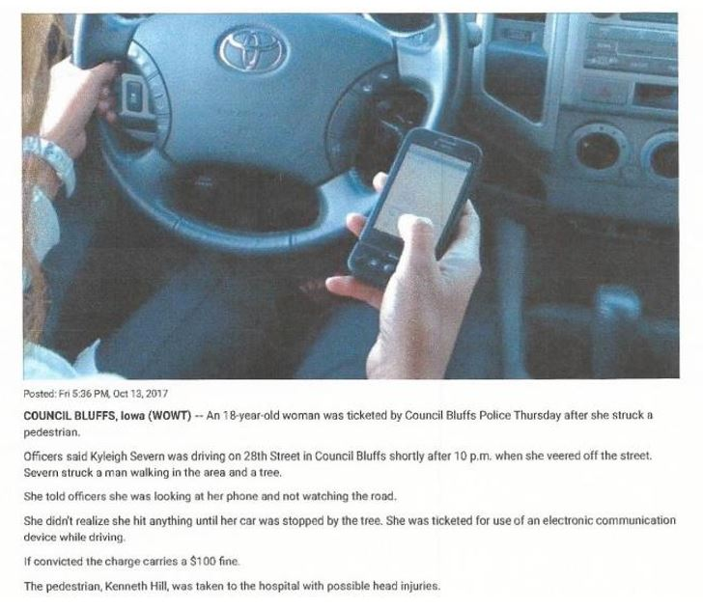
Inanimate Object or Human Being: Dumb Luck

Slide 17
Prevention
Do not use your cell phone while driving.
No call, text, or email is more important than your life
If you must take a call engage with your vehicles Bluetooth system, if it is not equipped with one keep an earpiece on you
Be aware of your vehicles functions before you hit the road, more and more vehicles while trying to simplify with one panel for everything have become more complex in the process.
If You are an Owner, make sure you have a cell phone policy…

Slide 18
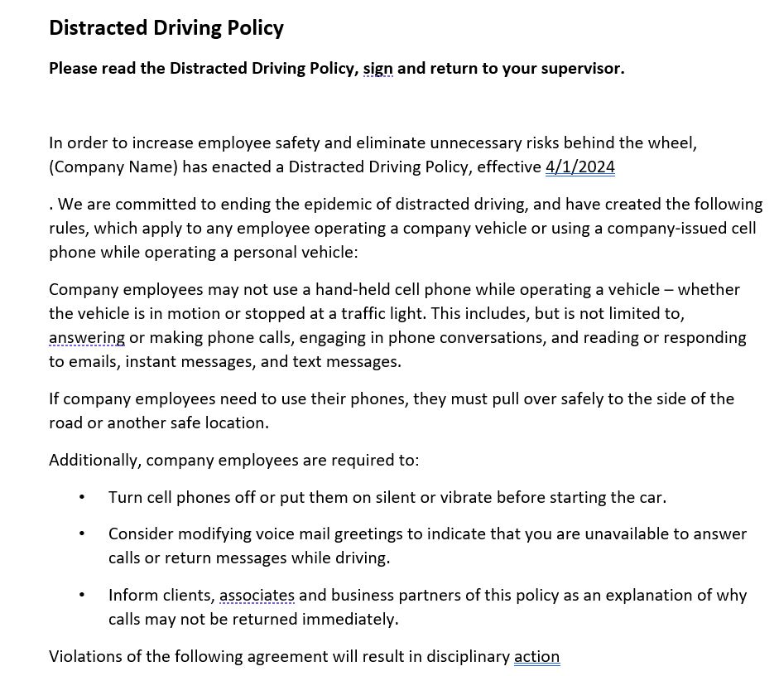

Slide 19
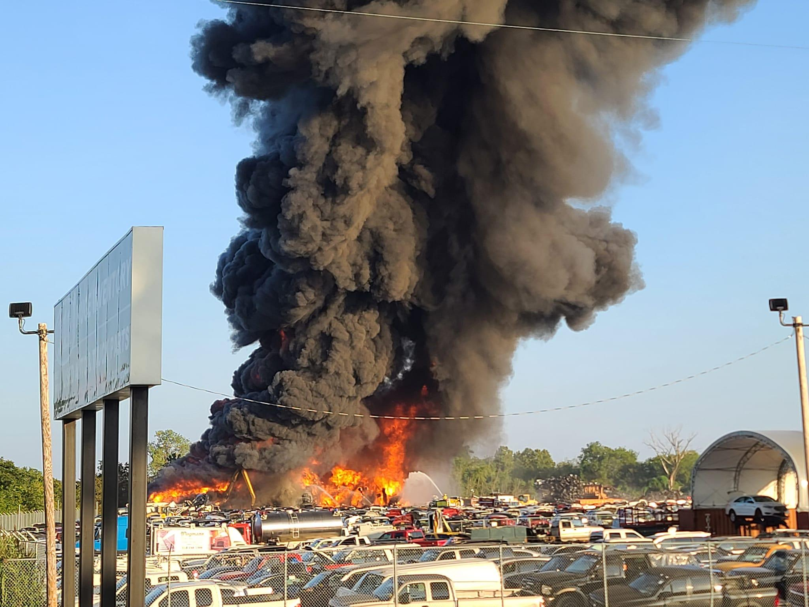
Fire: Causes and Best Practices for Prevention

Slide 20
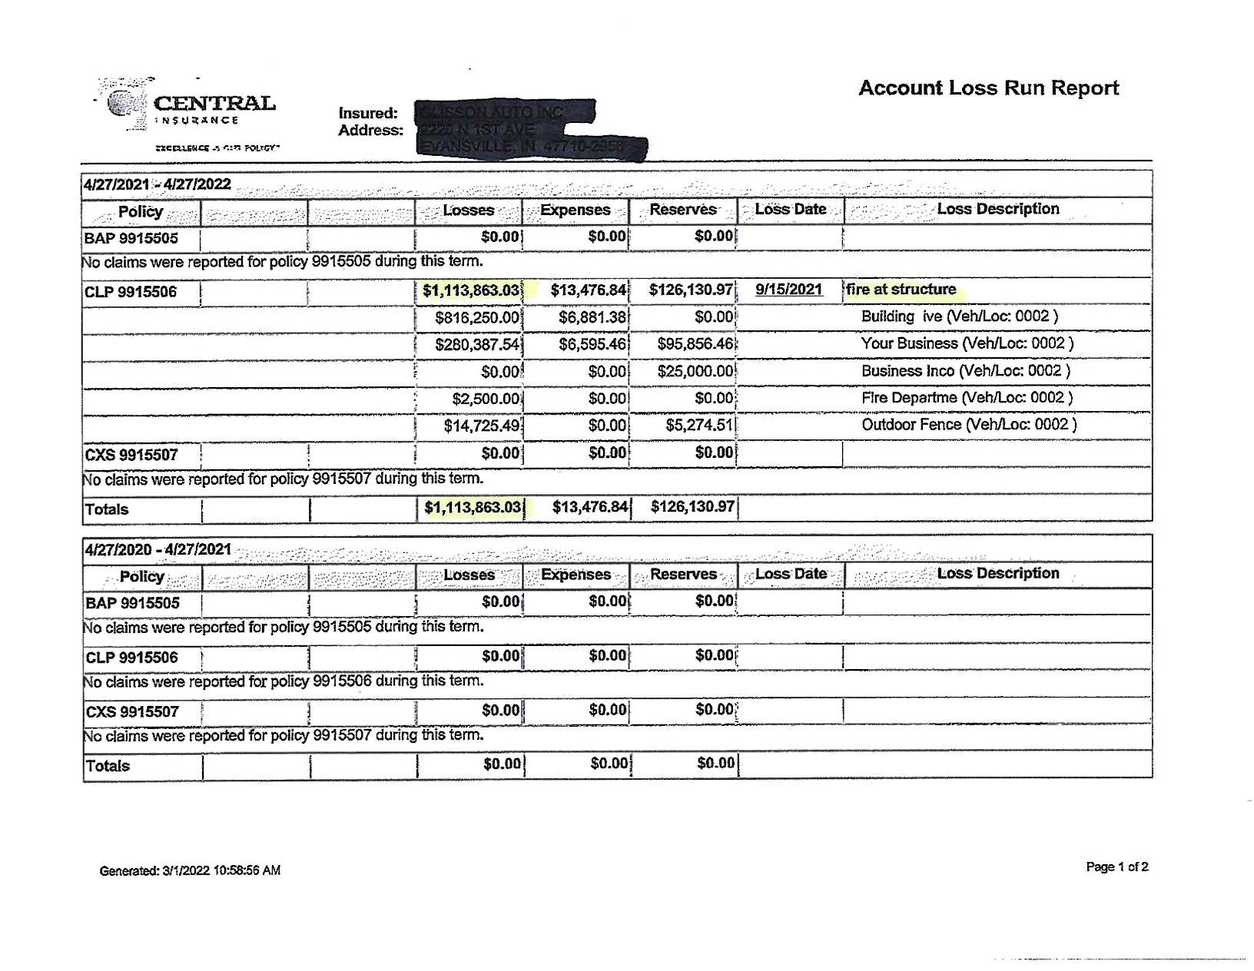
How Bad Could a Fire Be…

Slide 21
Cutting Torches
Misuse of cutting torches is one of the most common causes for a fire in the recycling industry.
It is so common some insurance carriers have assigned a higher deductible specifically for fires caused by torches
Best Practices:
If you have the option to use a Sawzall or a torch, always use the Sawzall when available.
Have a designated area for torch usage. This area should have clearly marked fire extinguishers and a posted map of the building with exits and extinguishers marked.
Use torches outside when possible
Never operate torches neared sealed barrels or any flammable materials

Slide 22
Improper Fluid Draining
Not having a plan in place for proper fluid draining can lead to potential losses.
Almost all fluids inside a vehicle is flammable especially gasoline
Best Practices:
Never take a torch to gas tank of a vehicle, even if its completely drained the fumes inside can still be flammable.
Have a proper system in place, make use of a rack system or a gas caddy.
Store all drained fluids in industry approved containers.

Slide 23
Smoking…
The hot ash from a cigarette is extremely flammable and if blown, flicked, or discarded in the wrong place can lead to devastating results
Most flammable vapor hangs about 2 feet off the ground, meaning ash falling to the floor is putting it into the hotzone
Best Practices:
Don’t allow smoking anywhere in the building and have a designated area outdoors over 25 feet away from a structure
Have proper signage around the buildings and designated the area
As a former smoker myself, the best practice truly is to quit.

Slide 24
Improper Vehicle Storage
A vehicle catching fire creates a domino effect either burning the vehicles around it or if stored inside lead to a building fire
Battery connections are one of the leading causes of vehicle fires
Best Practices:
Removing batteries is already a common part of the dismantling process, but as you take vehicles in before dismantling make sure that all batteries are disconnected.
Any vehicle that is stored inside should have its battery disconnected for overnight or weekend storage.
With electric vehicles becoming more common, make sure you have storage set up within your yard, and I recommend keeping this storage at least 25 feet from any structure or other vehicle

Slide 25
THANK YOU
TJ Phelan
Account Executive
Arrowhead Automotive Aftermarket
tphelan@arrowheadgrp.com
(574)344-6592

